Slide 1
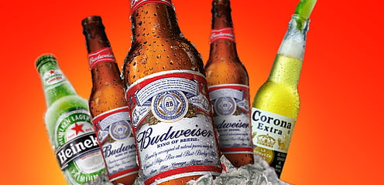
Which Ad Pulled Best?
By: Julia See

Slide 2
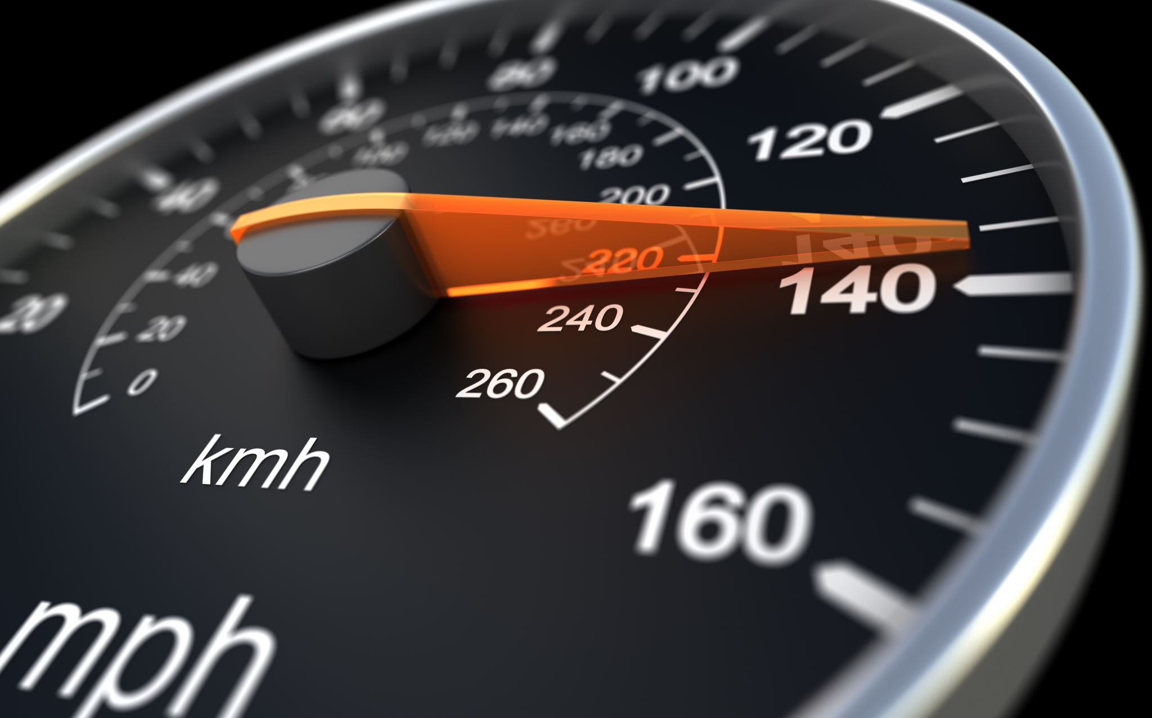
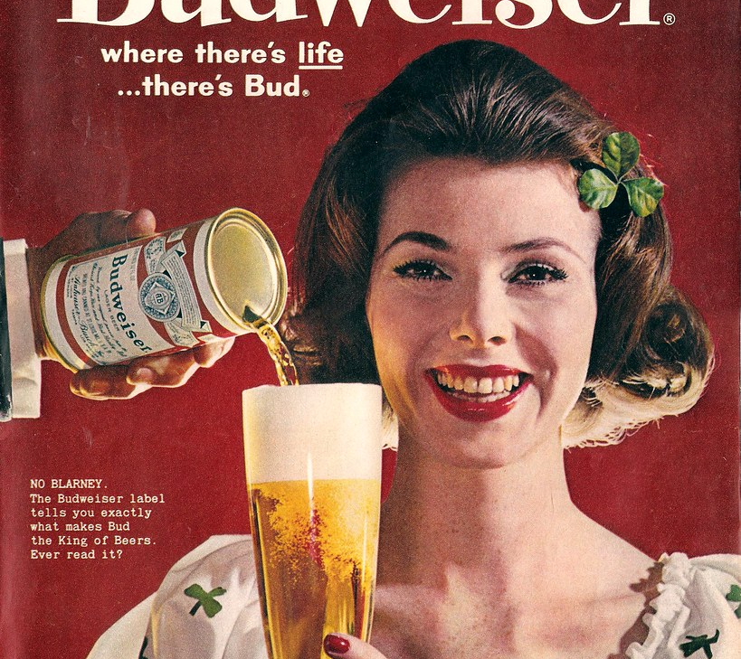
Don’t Drink and Drive (Budweiser)
https://youtu.be/DdbmJWzOlBY?si=pNvLW1uz2JsaLHNa

Slide 3
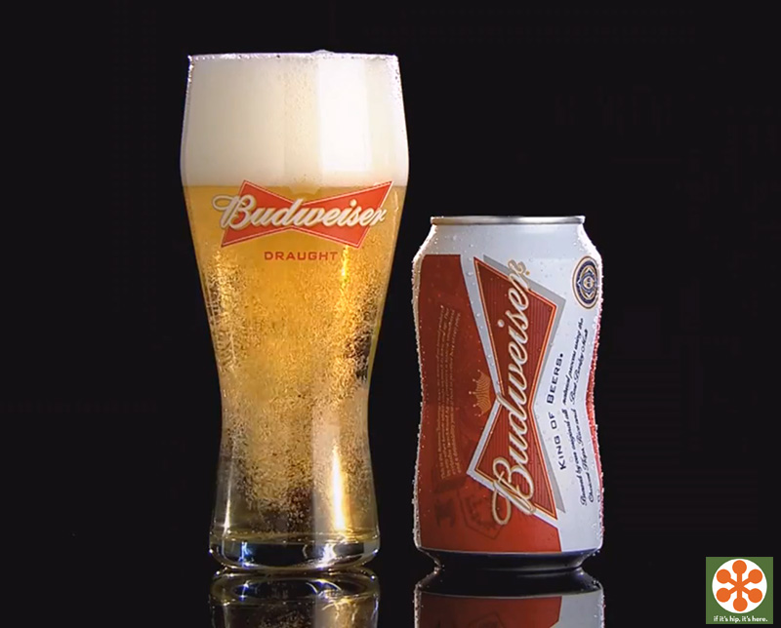
Opinion on the Budweiser Ad
Ad descriptive and Placement- 8; Good, got its point across; unsafe to drink and drive
Ad Recall- 10; Excellent, memorable to the public on purpose behind ad
Product Benefit- 9; ad was beneficial allowing audience to capture a lifeline statement. Don’t drink and drive!
Persuasive- 10; persuaded the audience to drink safely

Slide 4

Continued..
Why?
19; Excellent
Real testing shows that performance is predicted
Tested it and showed that it came to be accurate
Results can be more artificial through testing
Proven to be unsafe to drink and drive
Text Vocab- 18; Good
This ad was specific, leading to be more successful
Strong delivering messages conveyed to audience
Yes, ad purposely addressed logical standards- 9
logic, reasoning, relevance, accuracy, depth
Organization- 8; good organization
its reasoning behind the ad
ad had a good purpose behind it
what it was trying to convey
showing effective organization
audience can see through ad, the message

Slide 5
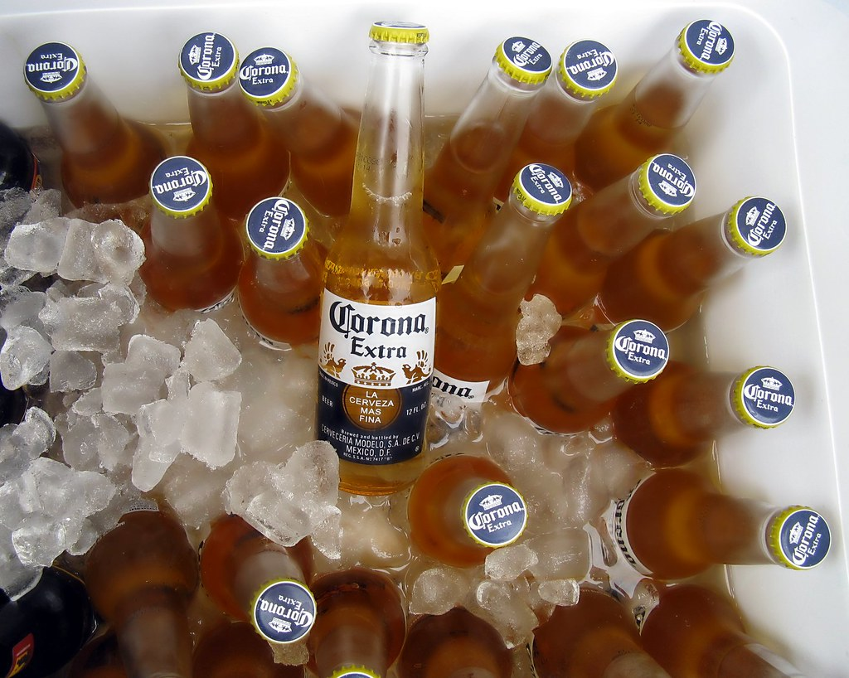
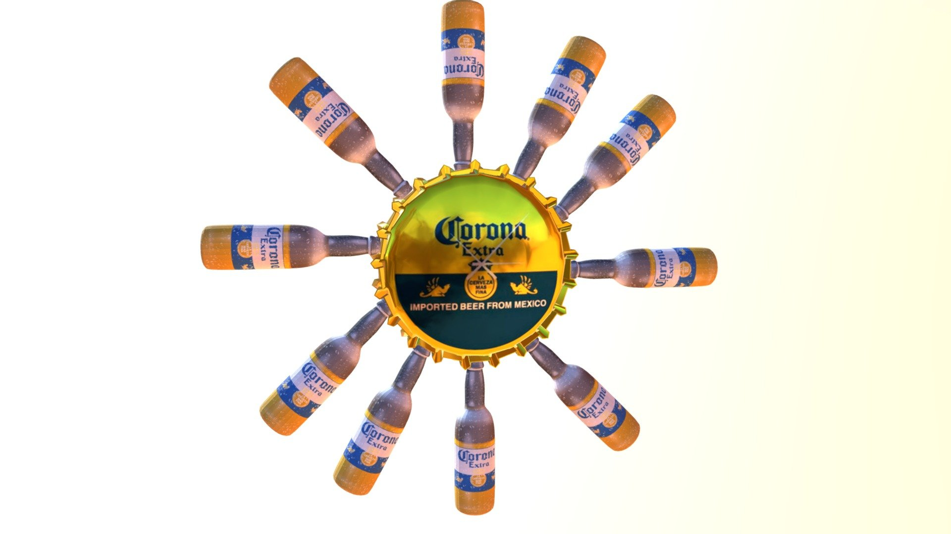
Corona Beer
https://youtu.be/mLerrgININk?si=HbeLuW6gcmNZtF81

Slide 6
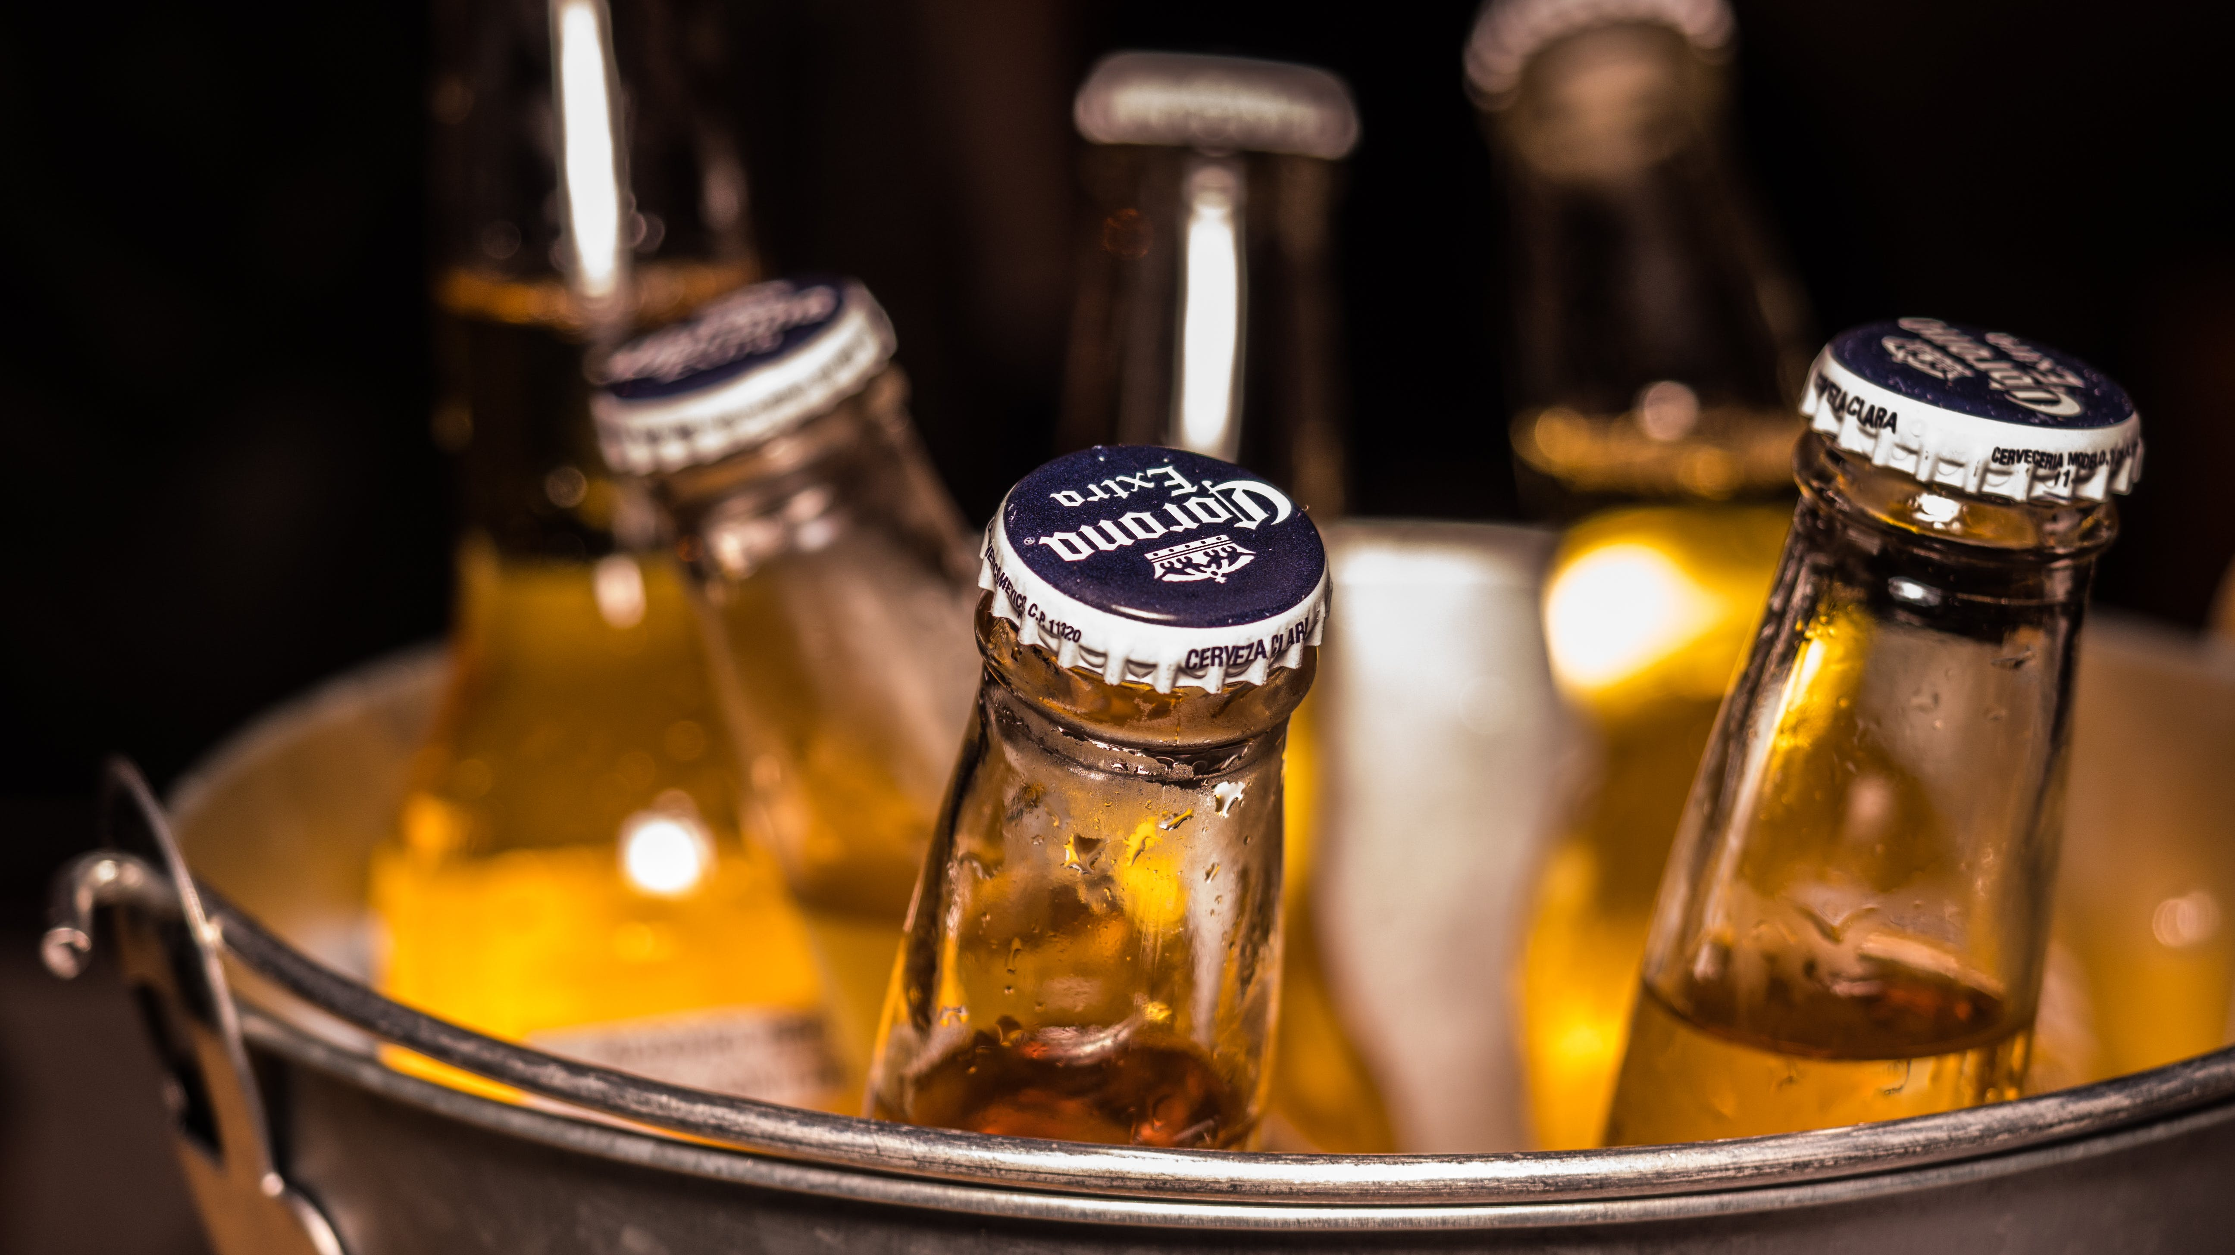
Opinion on Corona Ad
Placement -9; audience able to enjoy the ad, grab audience attention
Better recall-9; better recall through entertainment , Strong, unique recall
Budweiser had better recall given memory
Product benefit-8; displayed product through entertainment ad
Persuasive-7, the ad was persuasive through enjoyment to drink happlily
Whereas Budweiser was persuading to drink safely

Slide 7
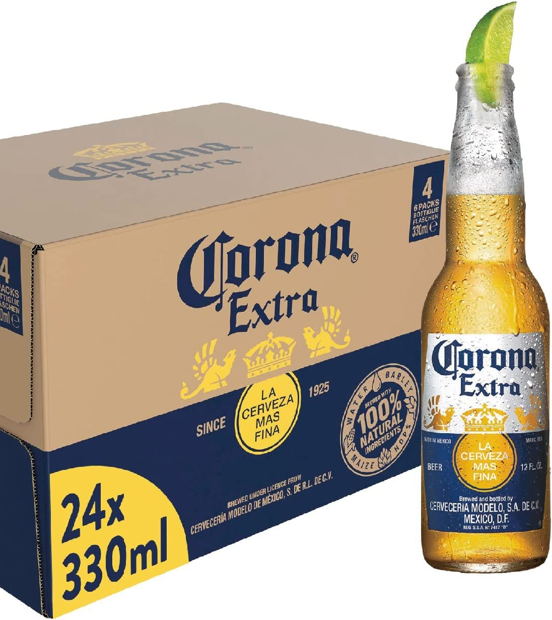
Continued..
Why?
18
Recall is the ad being memorable, persuasion is persuading audience
Budweiser had more recall as Corona had more persuasion
Txt-18
Ad was impressive, the ad resulted in good advertising, catchy, well-known ad
Company was interested in engaging, reenforcing positive imagery, how audience will feel
Audience could pick up on they enjoyable ad, perceiving it to show drink happily
Critical thinking-9
Ad had purpose, reasoning, logic, importance, accuracy
Organizaion-9
Ad was organized with the entertainment expressing through scenery, conveying drink happily

Slide 8
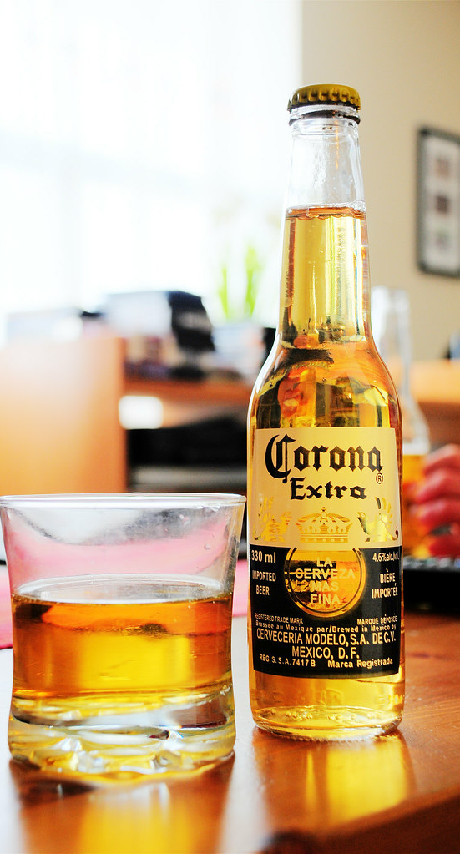
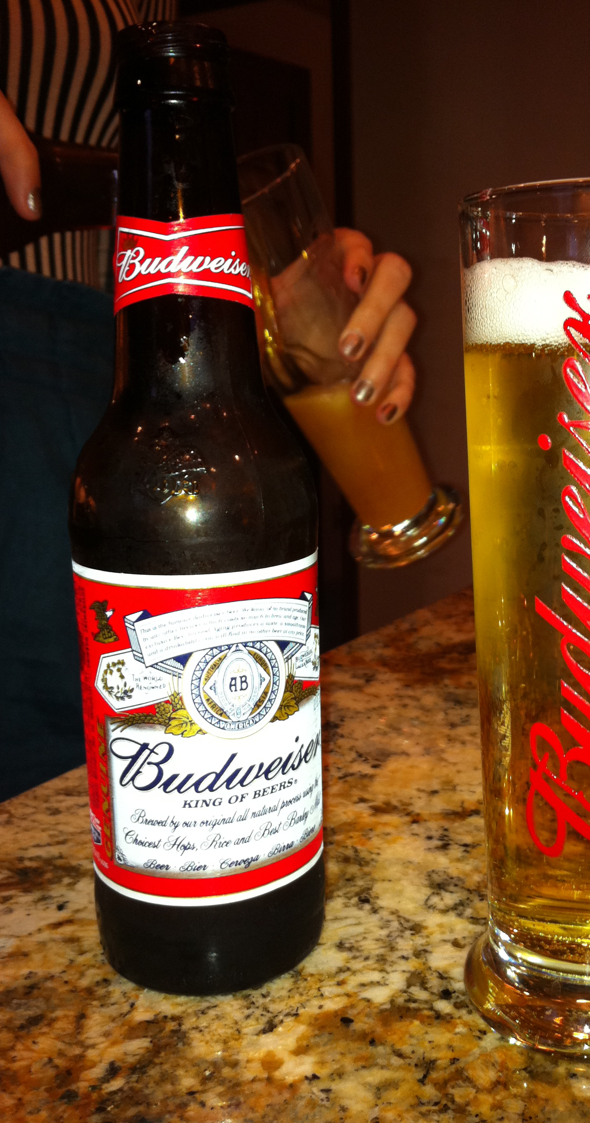
Which ad was better?
Budweiser
Better recall
More resourceful purpose
Stronger message
Statistical reasoning
Stats imply drinking and driving not being safe
Corona
Strong recall on entertainment aspects
Strong reasoning
Implying to drink happily
Overall, Budweiser had better ad

